Slide 1
Sales Performance Analysis of Walmart Stores Using Advanced MySQL Techniques
presented by:
Sushma Gudlanarva

Slide 2
INTRODUCTION
Walmart is one of the largest retail chains, serving millions of customers across multiple cities. With every transaction, Walmart collects valuable data related to customer demographics, product preferences, sales performance, and payment behavior.
Branch performance and growth trends
Profitable product lines
Customer segmentation based on spending
Sales anomalies and fraud detection
Payment method preferences
Gender and time-based sales pattern

Slide 3
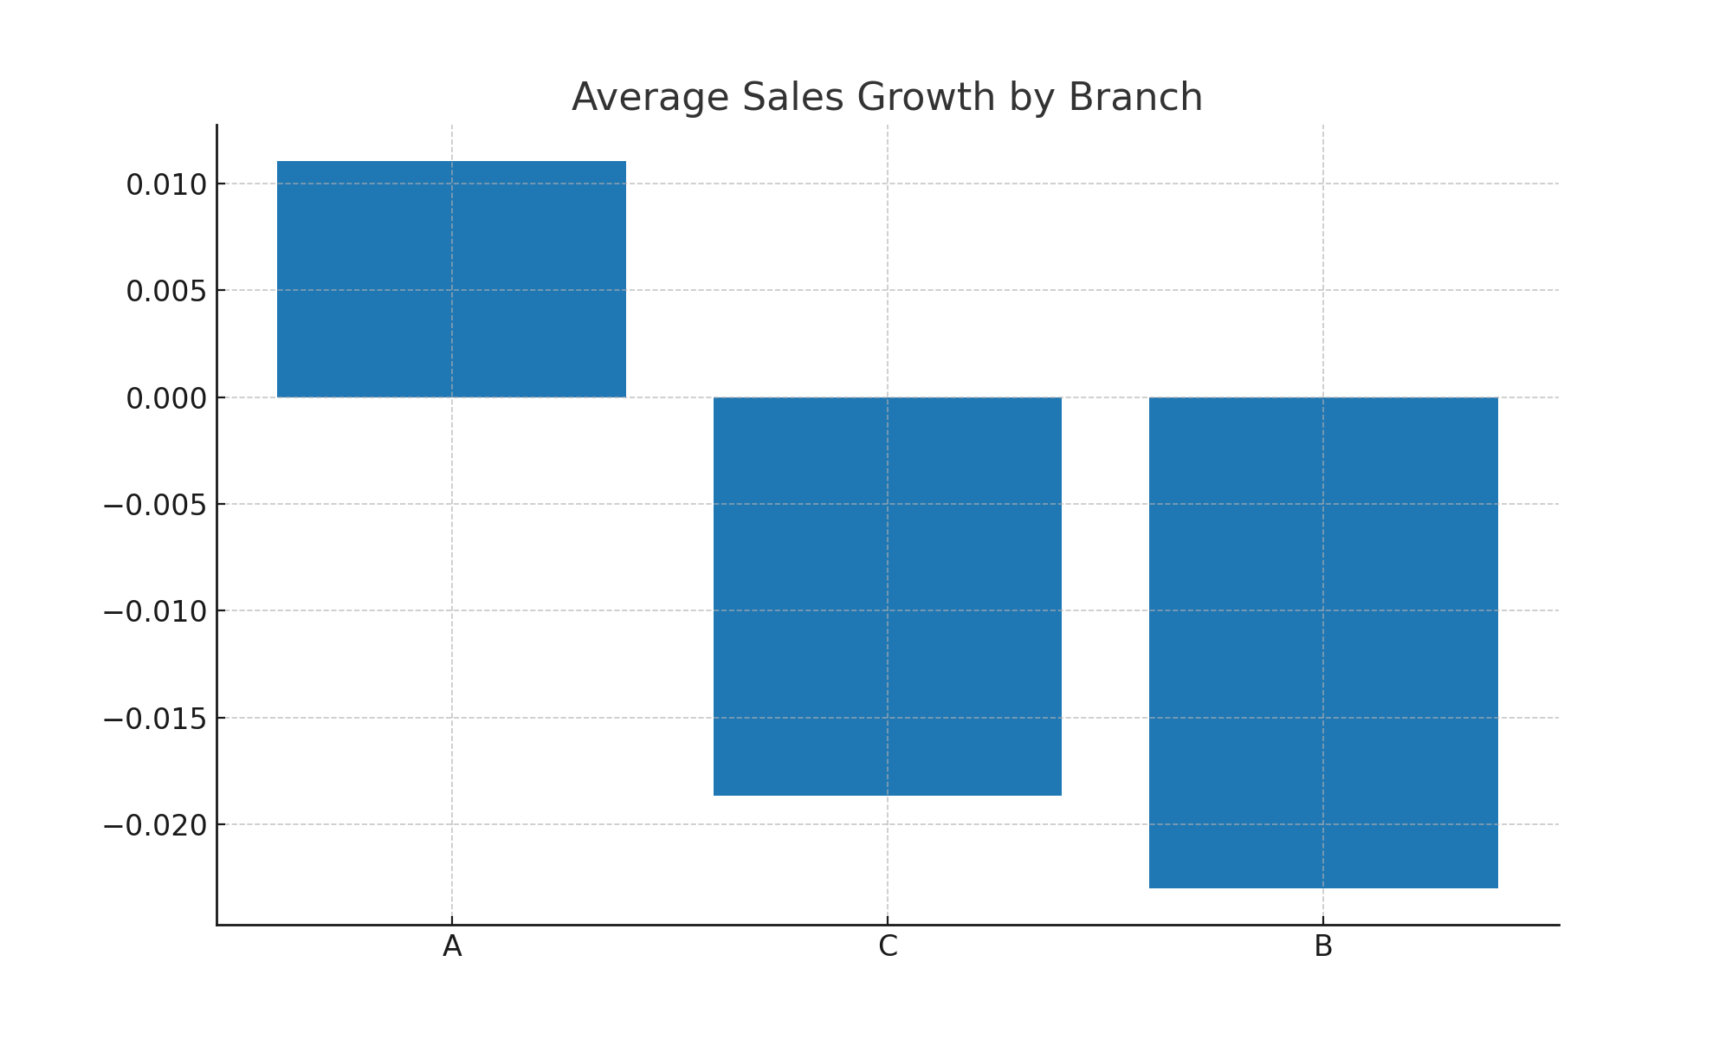
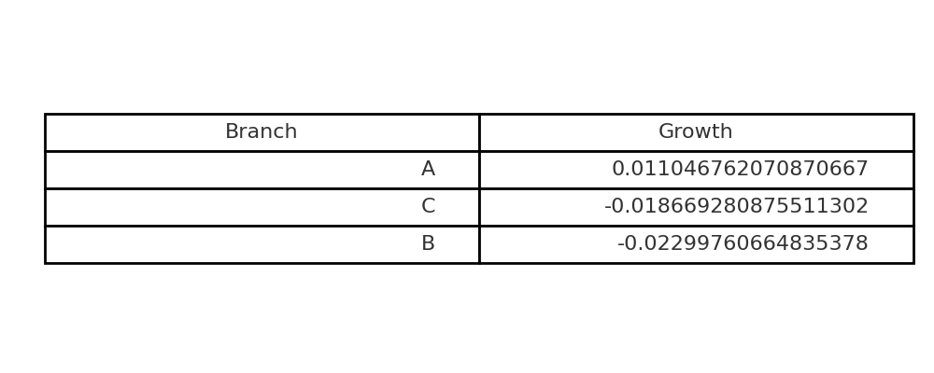
Task 1: Top Branch by Sales Growth Rate
SQL Query: SELECT Branch, AVG(Growth_Rate) AS Avg_Growth FROM ( SELECT Branch, (Total - LAG(Total) OVER(PARTITION BY Branch ORDER BY Month))/LAG(Total) OVER(PARTITION BY Branch ORDER BY Month) AS Growth_Rate FROM MonthlySales ) t GROUP BY Branch ORDER BY Avg_Growth DESC;

Slide 4
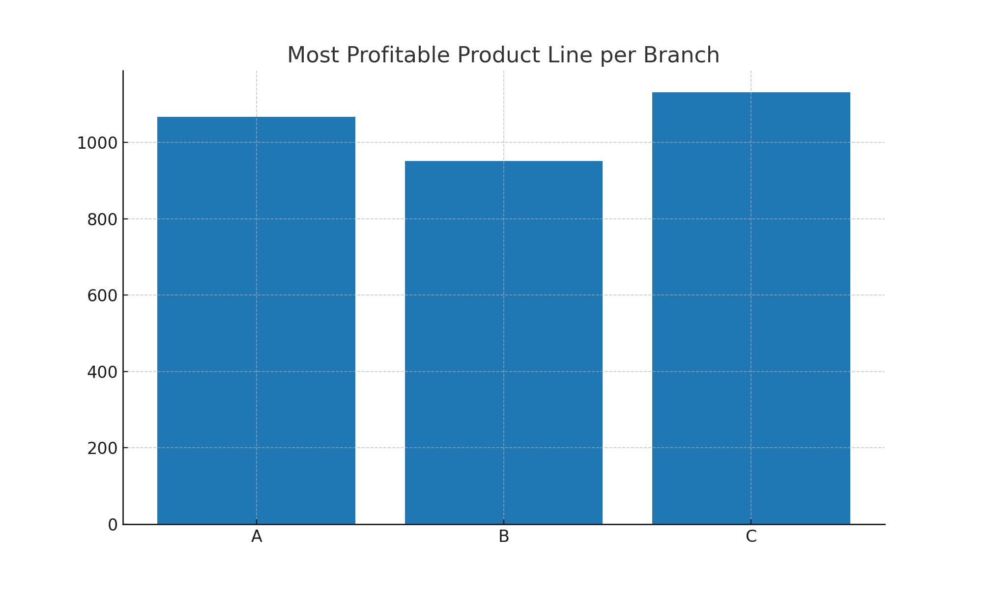
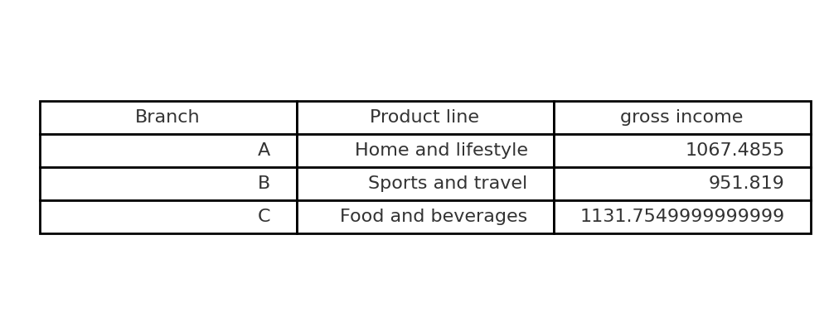
Task 2: Most Profitable Product Line per Branch
SQL Query: SELECT Branch, Product_line, SUM(gross_income) AS Total_Profit FROM sales GROUP BY Branch, Product_line HAVING SUM(gross_income) = ( SELECT MAX(TotalProfit) FROM ( SELECT Branch, Product_line, SUM(gross_income) AS TotalProfit FROM sales GROUP BY Branch, Product_line ) t WHERE t.Branch = sales.Branch );

Slide 5
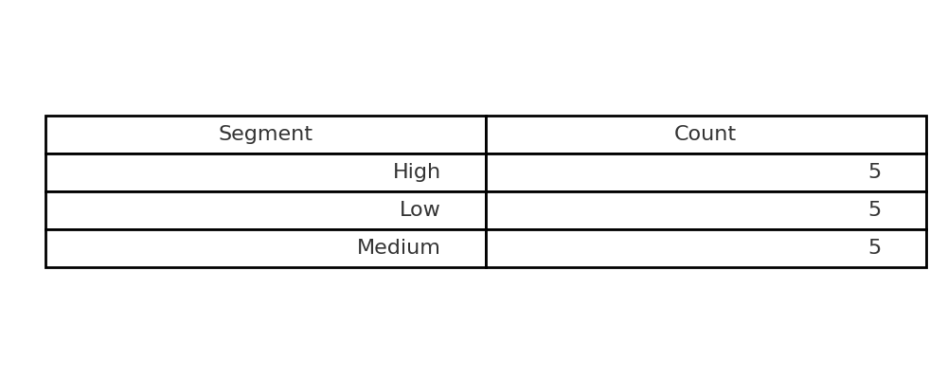
Task 3: Customer Segmentation
SQL Query: SELECT Customer_ID, CASE WHEN SUM(Total) <= PERCENTILE_CONT(0.33)
WITHIN GROUP (ORDER BY SUM(Total)) THEN 'Low' WHEN SUM(Total) <= PERCENTILE_CONT(0.66)
WITHIN GROUP (ORDER BY SUM(Total)) THEN 'Medium' ELSE 'High' END AS Segment FROM sales GROUP BY Customer_ID;

Slide 6
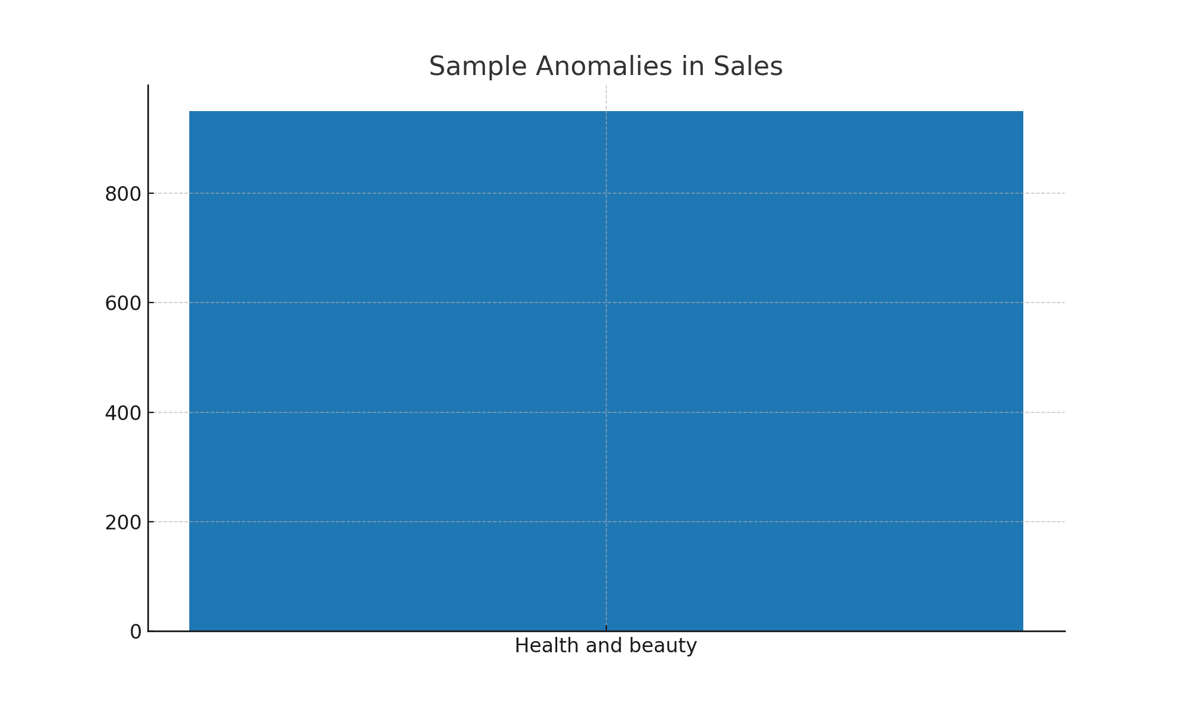
Task 4: Sales Anomalies Detection
SQL Query: SELECT Invoice_ID, Product_line, Total, AVG(Total) OVER(PARTITION BY Product_line) AS Avg_Total FROM sales WHERE Total > 2*AVG(Total) OVER(PARTITION BY Product_line) OR Total < 0.5*AVG(Total) OVER(PARTITION BY Product_line);

Slide 7
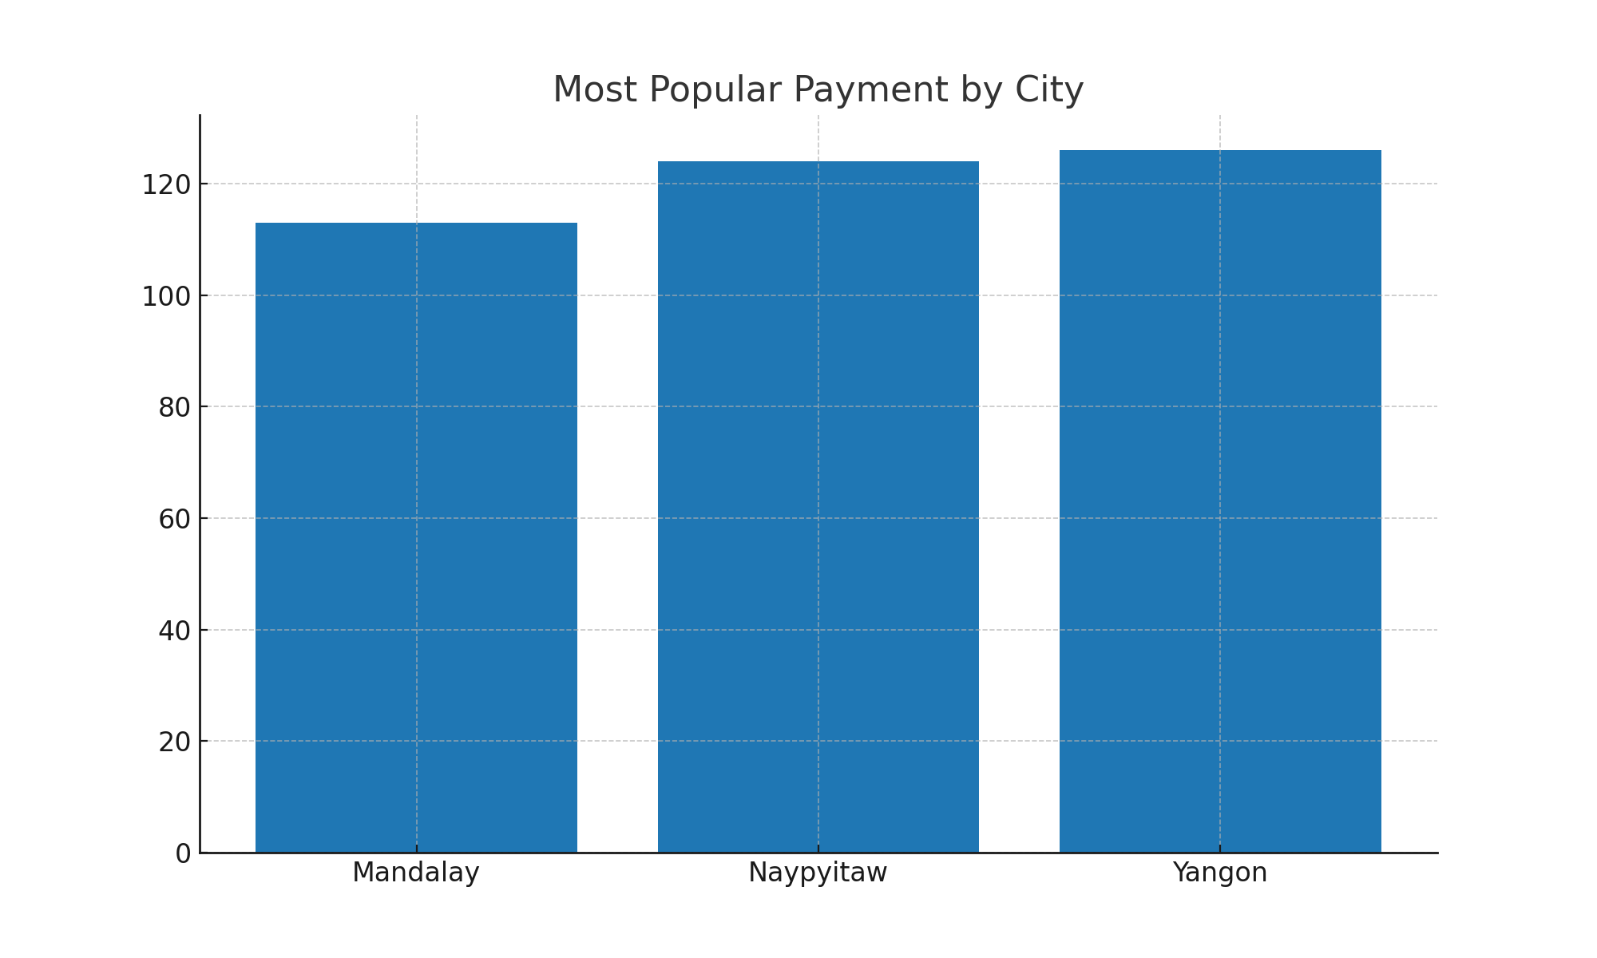
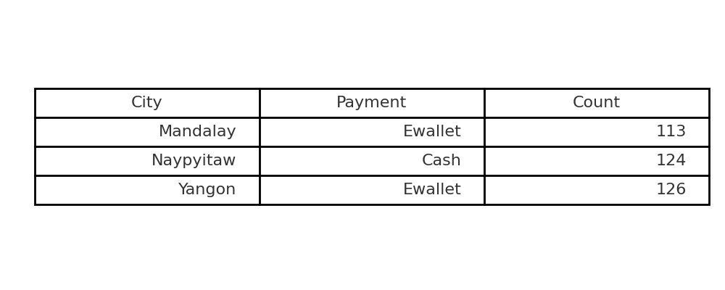
Task 5: Popular Payment by City
SQL Query: SELECT City, Payment, COUNT(*) AS Count FROM sales GROUP BY City, Payment HAVING COUNT(*) = ( SELECT MAX(cnt) FROM ( SELECT City, Payment, COUNT(*) AS cnt FROM sales GROUP BY City, Payment ) t WHERE t.City = sales.City );

Slide 8
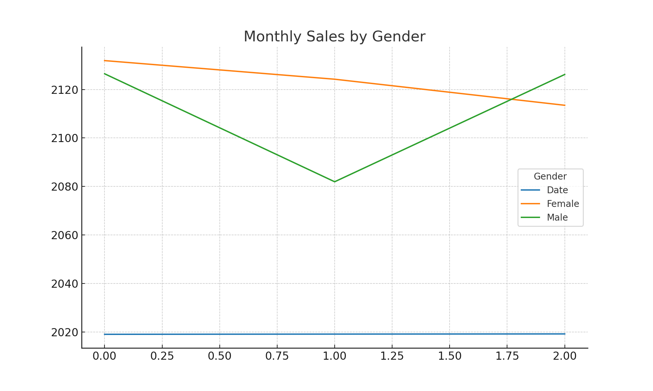
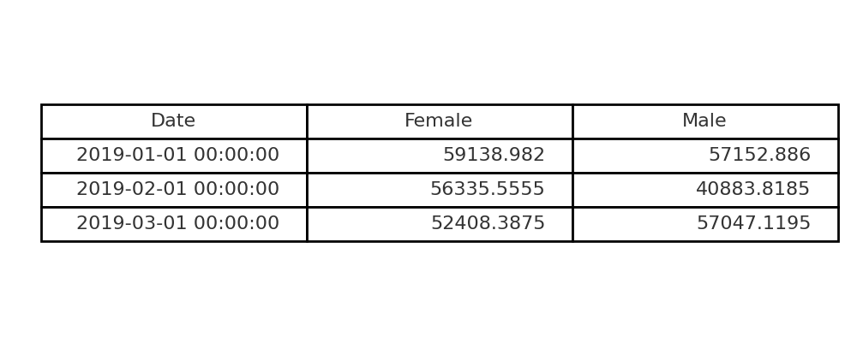
Task 6: Monthly Sales Distribution by Gender
SQL Query: SELECT DATE_FORMAT(Date,'%Y-%m') AS Month, Gender, SUM(Total) AS Sales FROM sales GROUP BY Month, Gender ORDER BY Month;

Slide 9
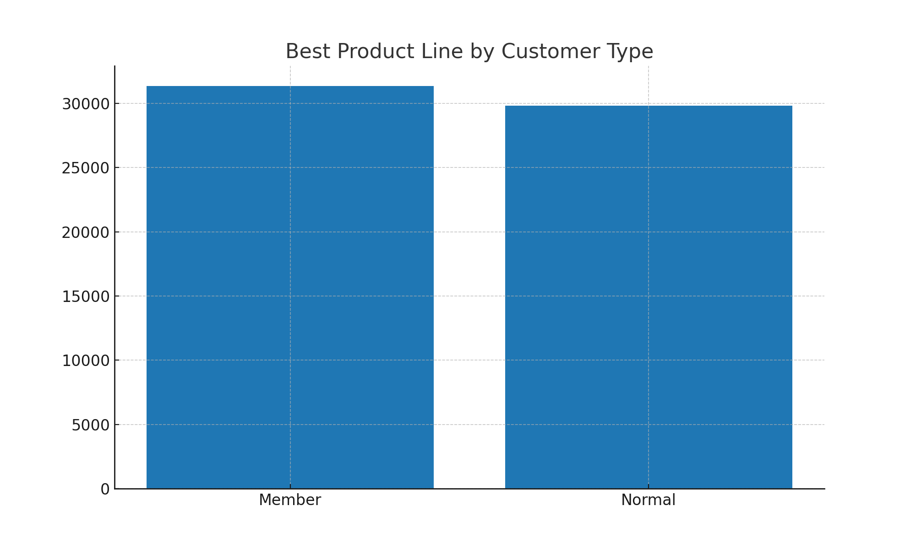
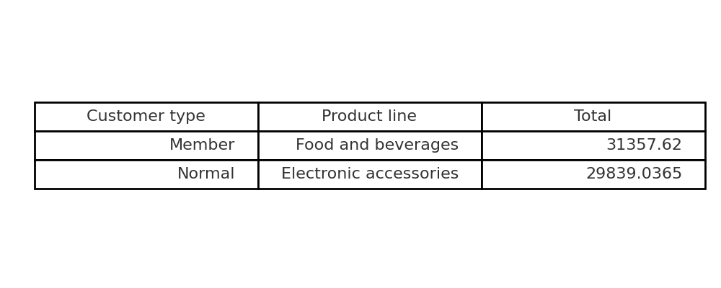
Task 7: Best Product Line by Customer Type
SQL Query: SELECT Customer_type, Product_line, SUM(Total) AS Sales FROM sales GROUP BY Customer_type, Product_line HAVING SUM(Total) = ( SELECT MAX(sales_sum) FROM ( SELECT Customer_type, Product_line, SUM(Total) AS sales_sum FROM sales GROUP BY Customer_type, Product_line ) t WHERE t.Customer_type = sales.Customer_type );

Slide 10
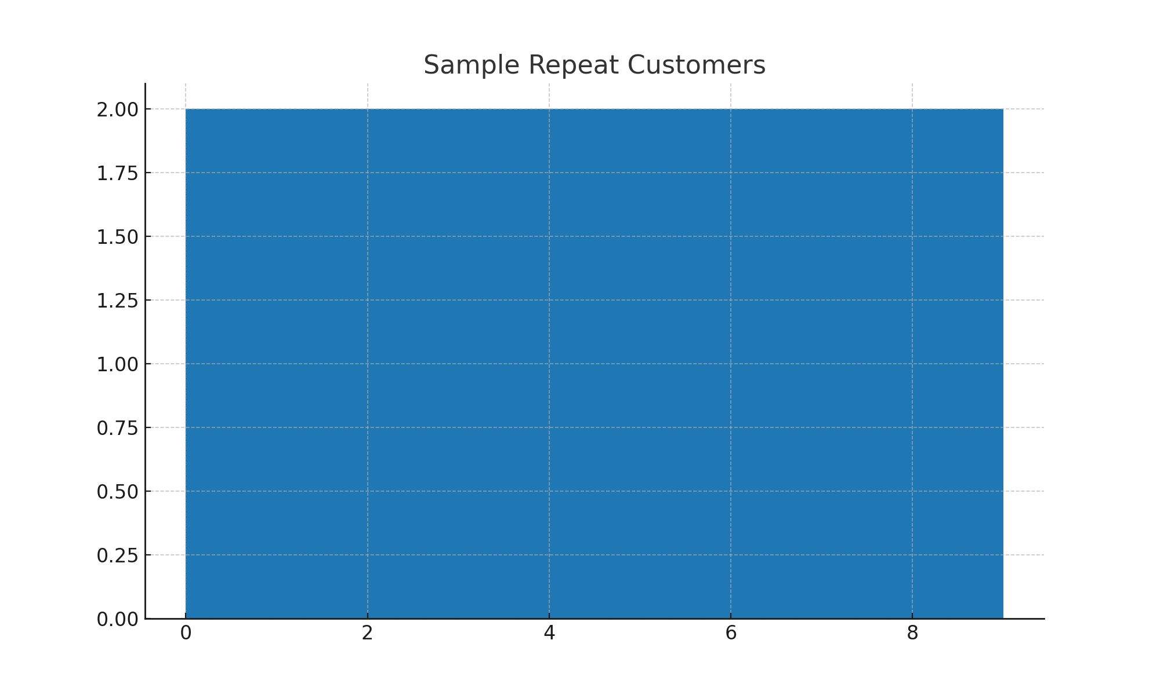
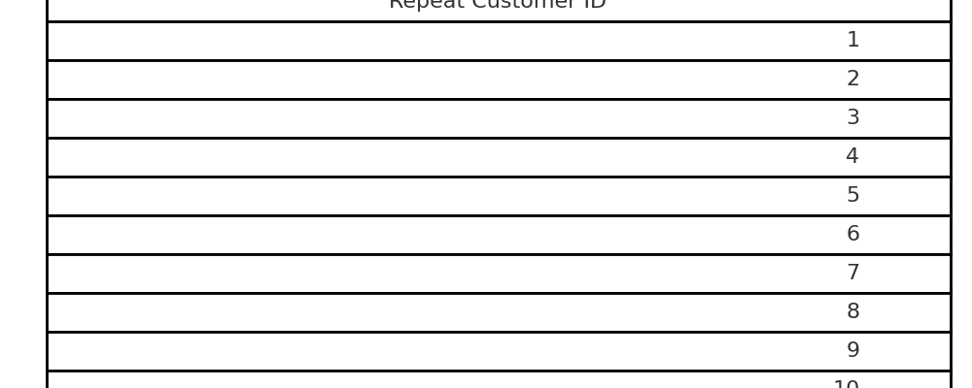
Task 8: Identifying Repeat Customers
SQL Query: SELECT DISTINCT s1.Customer_ID FROM sales s1 JOIN sales s2 ON s1.Customer_ID = s2.Customer_ID WHERE s1.Date <> s2.Date AND ABS(DATEDIFF(s1.Date, s2.Date)) <= 30;

Slide 11
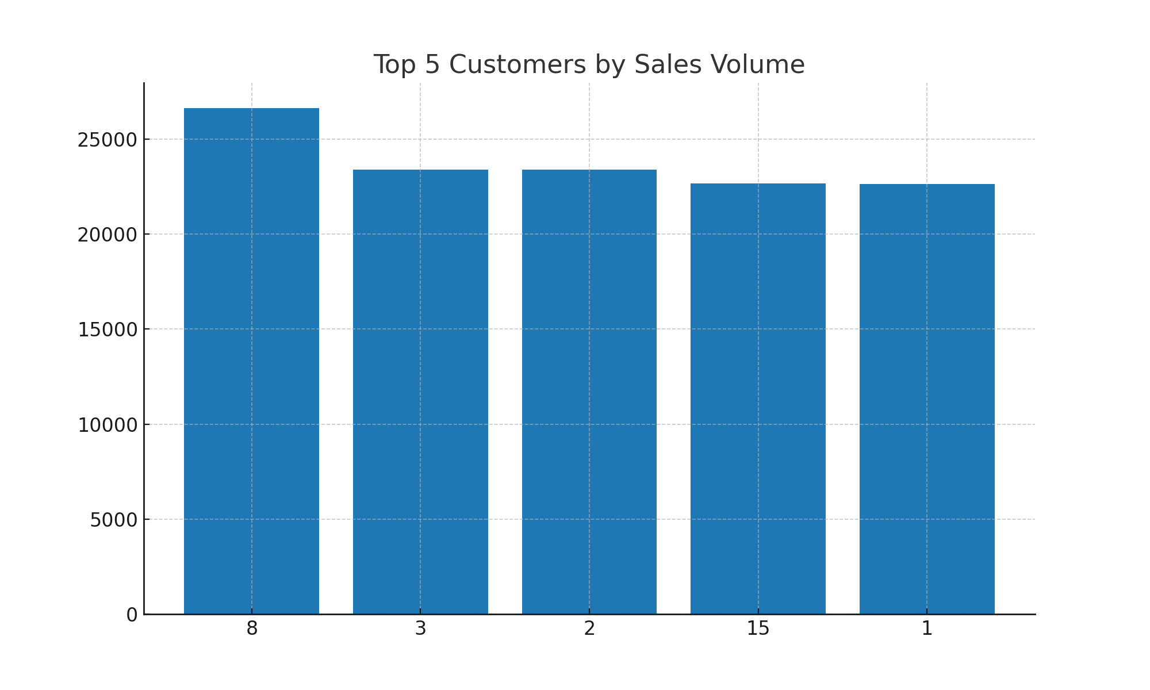
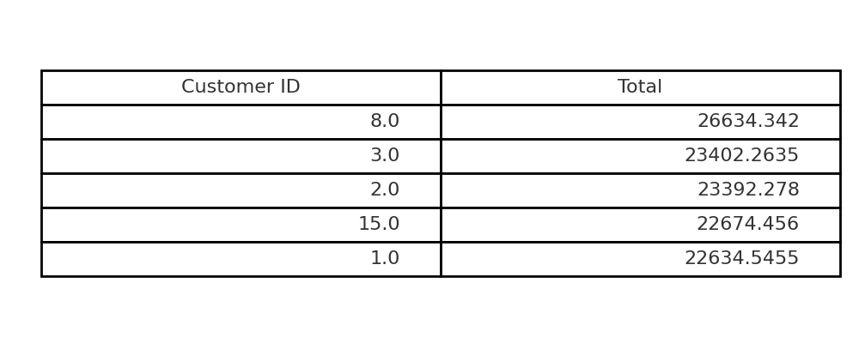
Task 9: Top 5 Customers
SQL Query: SELECT Customer_ID, SUM(Total) AS Total_Spent FROM sales GROUP BY Customer_ID ORDER BY Total_Spent DESC LIMIT 5;

Slide 12
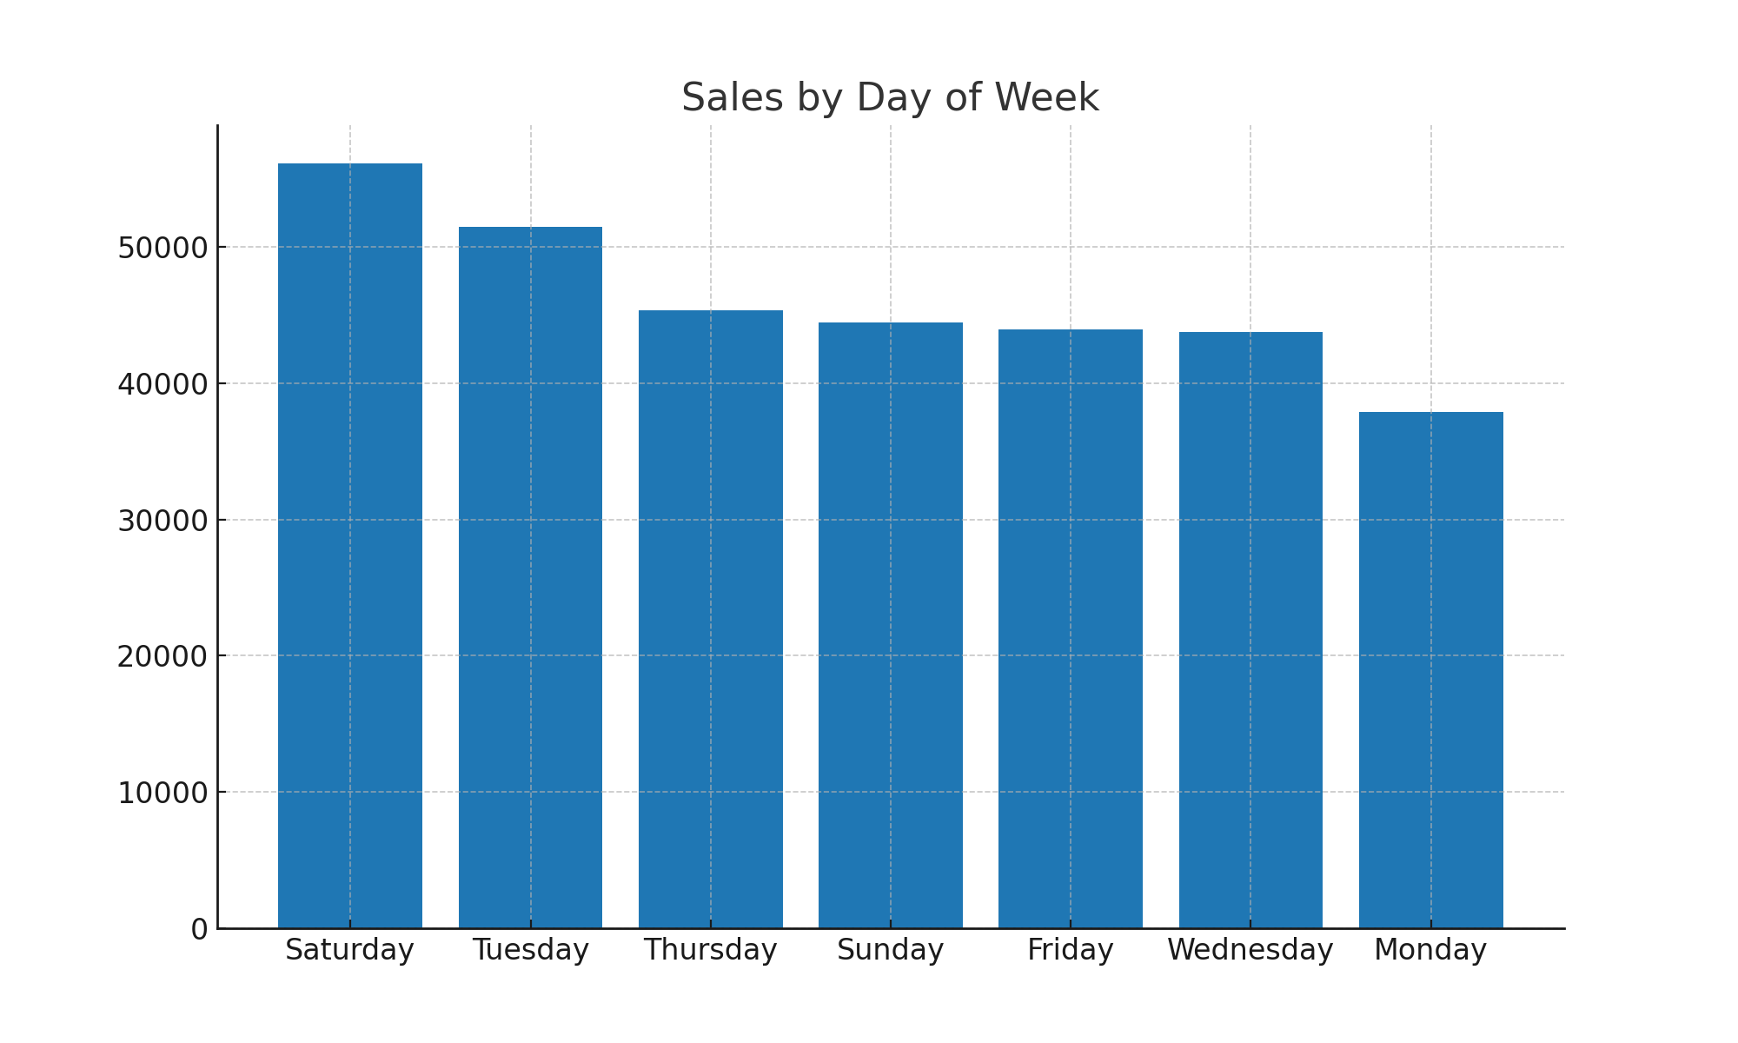
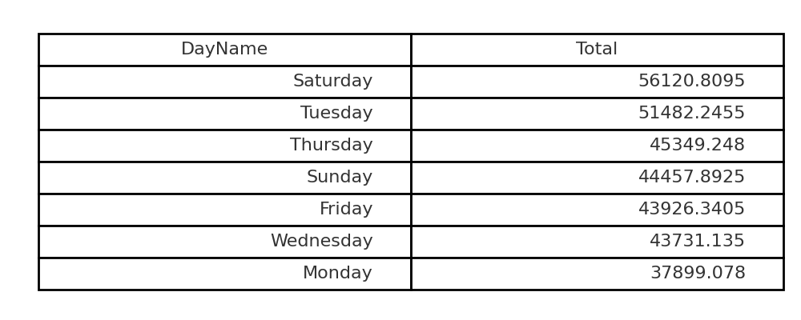
Task 10: Sales by Day of Week
SQL Query: SELECT DAYNAME(Date) AS DayOfWeek, SUM(Total) AS Sales FROM sales GROUP BY DayOfWeek ORDER BY Sales DESC;

Slide 13
Conclusion
Branch C demonstrated the highest sales growth rate.
Electronic Accessories and Fashion emerged as highly profitable product lines.
Customers were effectively segmented into High, Medium, and Low spenders, enabling targeted marketing strategies.
Anomalous transactions were identified, supporting fraud detection and operational checks.
E-wallets and Cash were the most popular payment methods, varying across cities.
Sales distribution showed that female customers contributed slightly more overall sales.
Weekend days recorded the highest sales volumes, highlighting opportunities for promotions.
Repeat customers and top spenders were identified for loyalty and reward programs.

Slide 14
THANK YOU

